Slide 1
Exp2

Slide 2
What is BIOS
BIOS is a firmware that is built into the computer’s motherboard.
It is stored on the BIOS chip of the motherboard.
It is nonvolatile.
Therefore, it holds data even there is no constant flow of power.
When booting up the computer, BIOS helps to initialize the computer’s hardware.
After the booting up process, it searches for a boot device such as optical or storage drive to boot the operating system and other programs.

Slide 3
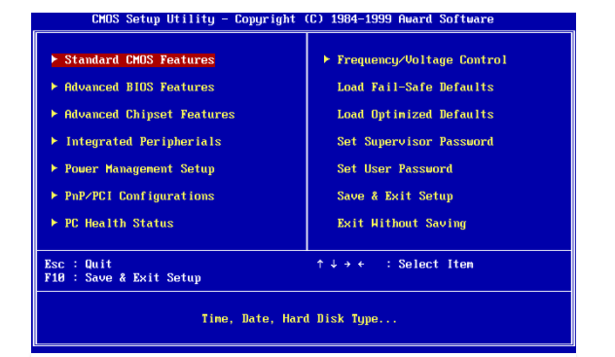
BIOS SETUP Screen

Slide 4
When you turn on the computer, the BIOS performs the Power On Self-Test.
It checks whether all the requirements are met and the hardware is working correctly before starting the operating system.
If the test is successful, the internal speaker will make a short single beep.
It indicates that the booting up process is normal.
If there are no beeps or multiple beeps, it indicates that there is something wrong in the system.

Slide 5
The beep code helps the user to identify the problem.
For example, if it is a continuous short beep, it can be a fault in RAM. If there are three beeps, it indicates that there is a fault in the keyboard.
The user can find out more about the beep codes from the manufacturers’ document.
It is possible to perform further troubleshooting according to the beep code.

Slide 6
What is CMOS
There are BIOS settings such as boot sequence, date and time and hardware settings.
These configuration settings are stored on the motherboard in a special chip called CMOS.
It is volatile and requires a constant flow of power to maintain the settings.

Slide 7
CMOS uses a battery called CMOS to maintain the settings when the computer is shut down.
It is a small button cell battery that can be seen on the surface of the motherboard.
If the battery is removed and then reattached, the BIOS will erase previously configuration settings and reset it back to the manufacturer’s default settings.

Slide 8
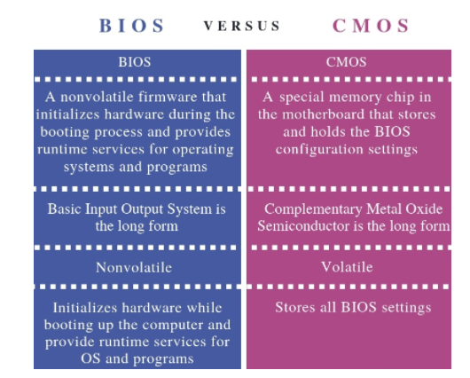

Slide 9
Computers manufactured in the last few years allow you to enter the BIOS setup using one of the five keys shown below during the boot process.
F1
F2 *
F10 **
Del
Esc

Slide 10
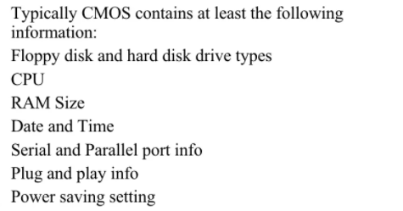

Slide 11
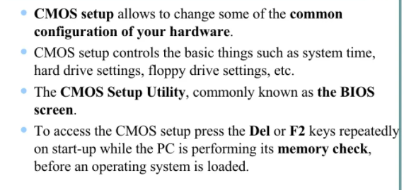

Slide 12
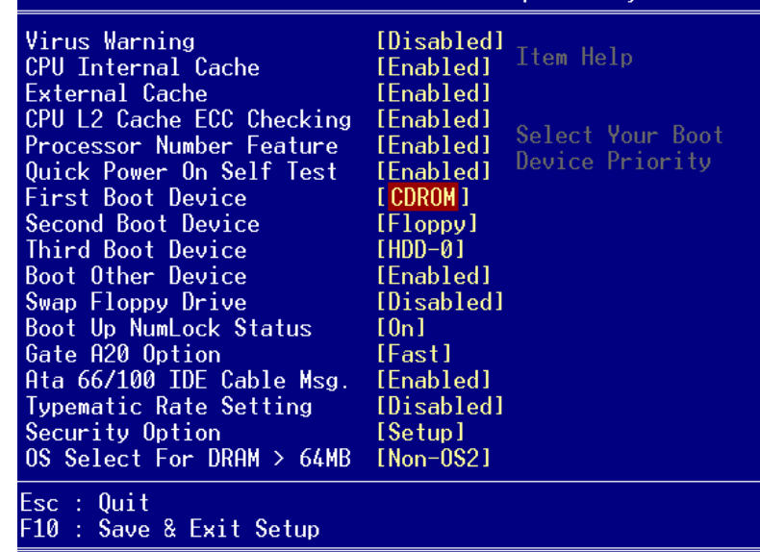

Slide 13
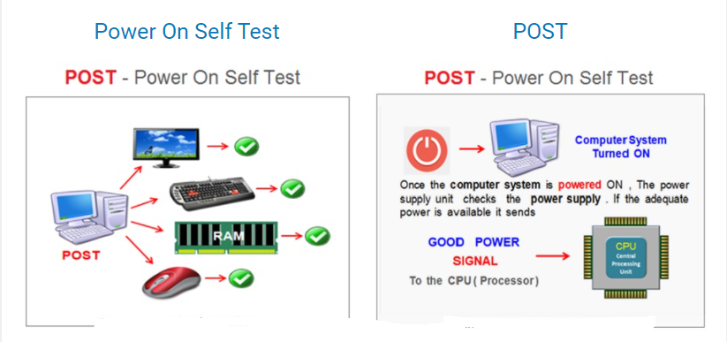

Slide 14
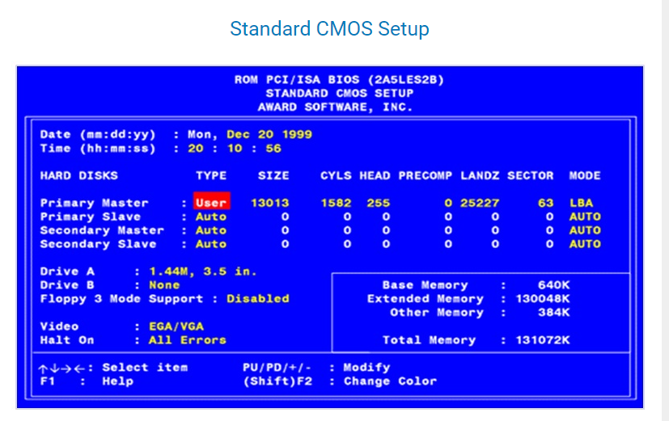

Slide 15
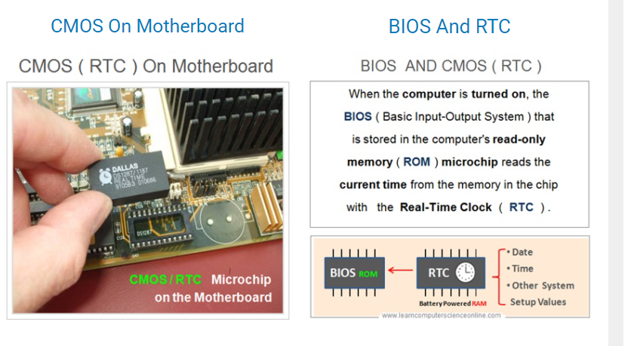

Slide 16
